Slide 1

Microservices in production
a case study
marin.prcela@minus5.hr

Slide 2
What are Microservices?
Do you need them?
How did we do it?

Slide 3
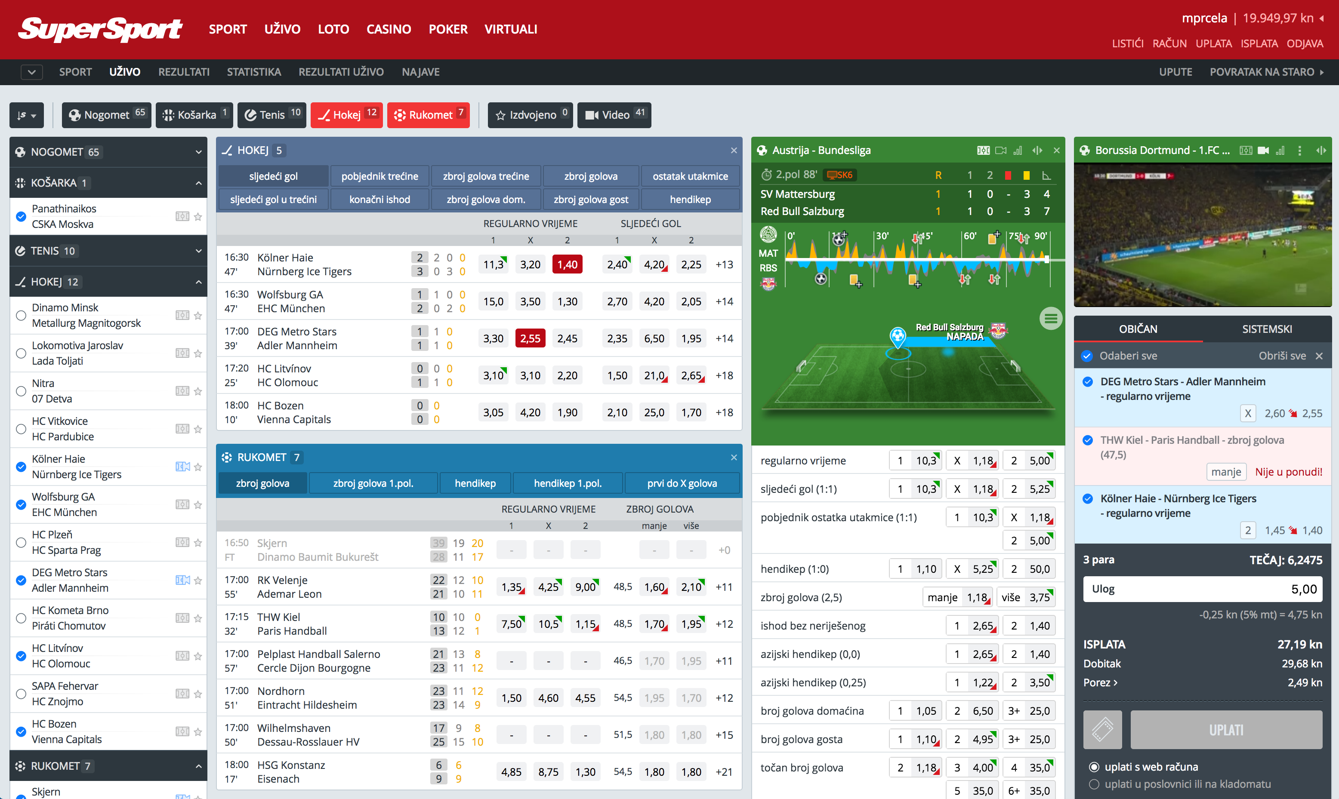

Slide 4
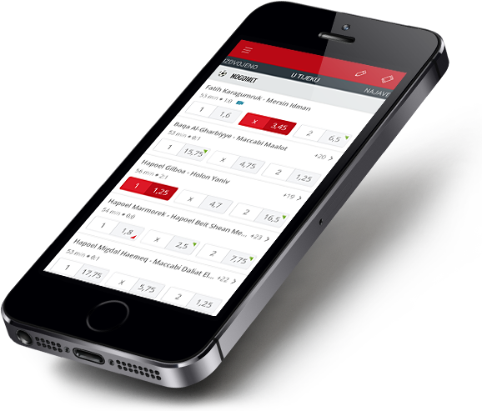
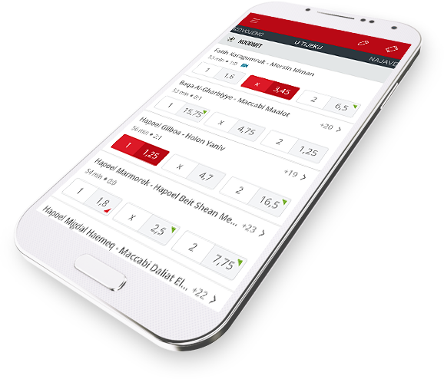

Slide 5
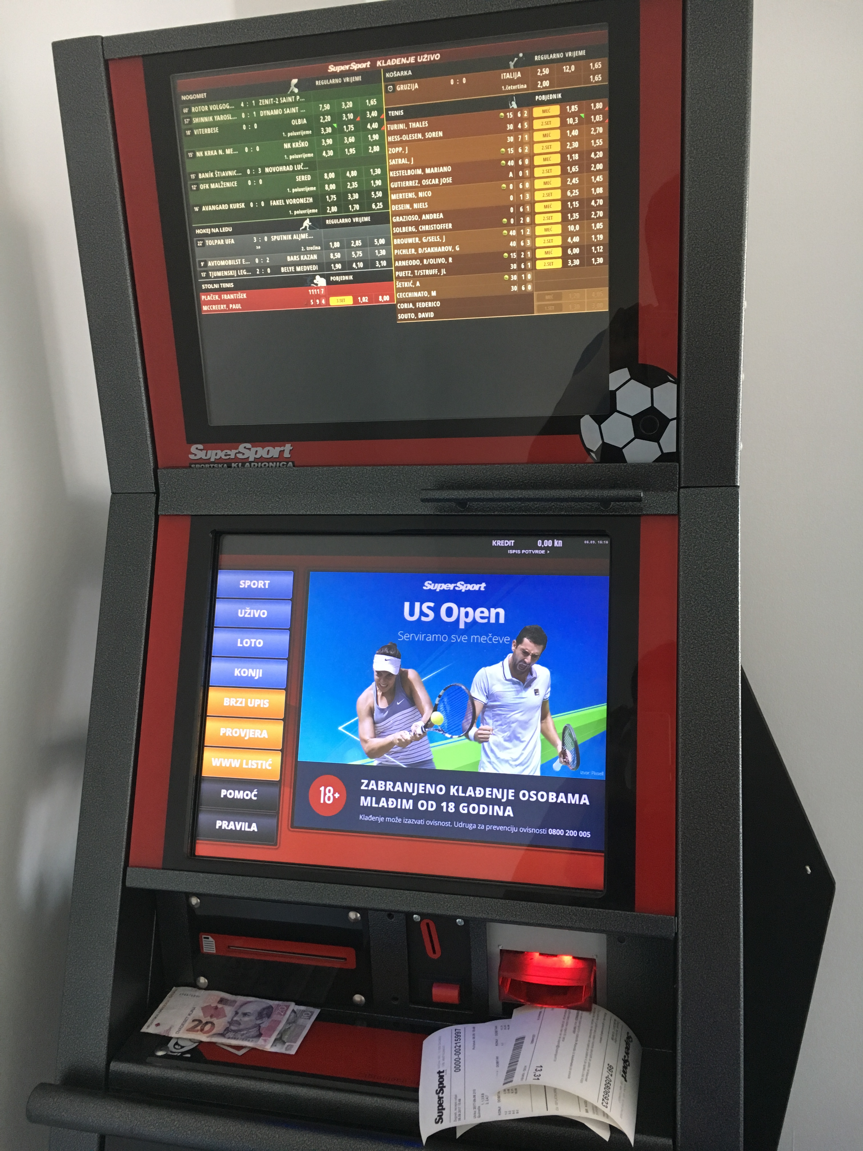

Slide 6
What are Microservices?

Slide 7
loosely coupled
business capabilities
enable continioius delivery
evolve techology stack

Slide 8
Monolith
Microservices
frontend
frontend
backend
tickets
odds
accounts

Slide 9
Do you need them?

Slide 10
Coupling
Putting network in the middle helps?
Joined data?

Slide 11


Slide 12
Latency
ticket already processed?
odds are
valid?
reserve
money
authorization?
store ticket
confirm
money
reservation

Slide 14
Scalability
tickets
odds
accounts

Slide 15
How did we do it?

Slide 16

github.com/minus5/examples-services

Slide 17




REST
Messaging
Service Discovery
Containerisation

Slide 18
APP
HTTP
HTTP
SENSOR
WORKER
SENSOR
WORKER
APP
HTTP
HTTP

Slide 19
You are here
REST
Messaging
Service Discovery
Containerisation

Slide 20
Messaging
SENSOR
WORKER
APP
NSQ

Slide 21
Routing
pub/sub
load balancing
… and anti-patterns!

Slide 22
Edge cases
stale messages
missed messages
order of receiving

Slide 24
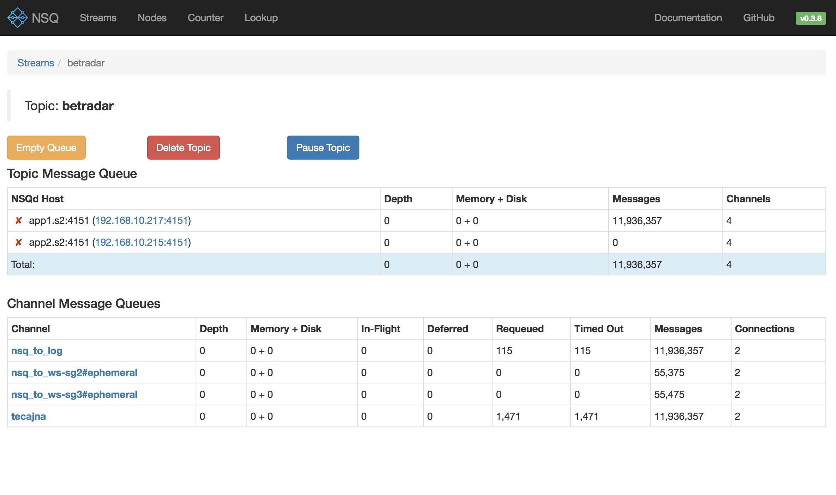

Slide 25
REST
Messaging
You are here
Service Discovery
Containerisation

Slide 26
Service discovery
name
location
health check

Slide 27
FindING service
setup Consul as DNS
poll Consul with HTTP
events from Consul
consul-template

Slide 28
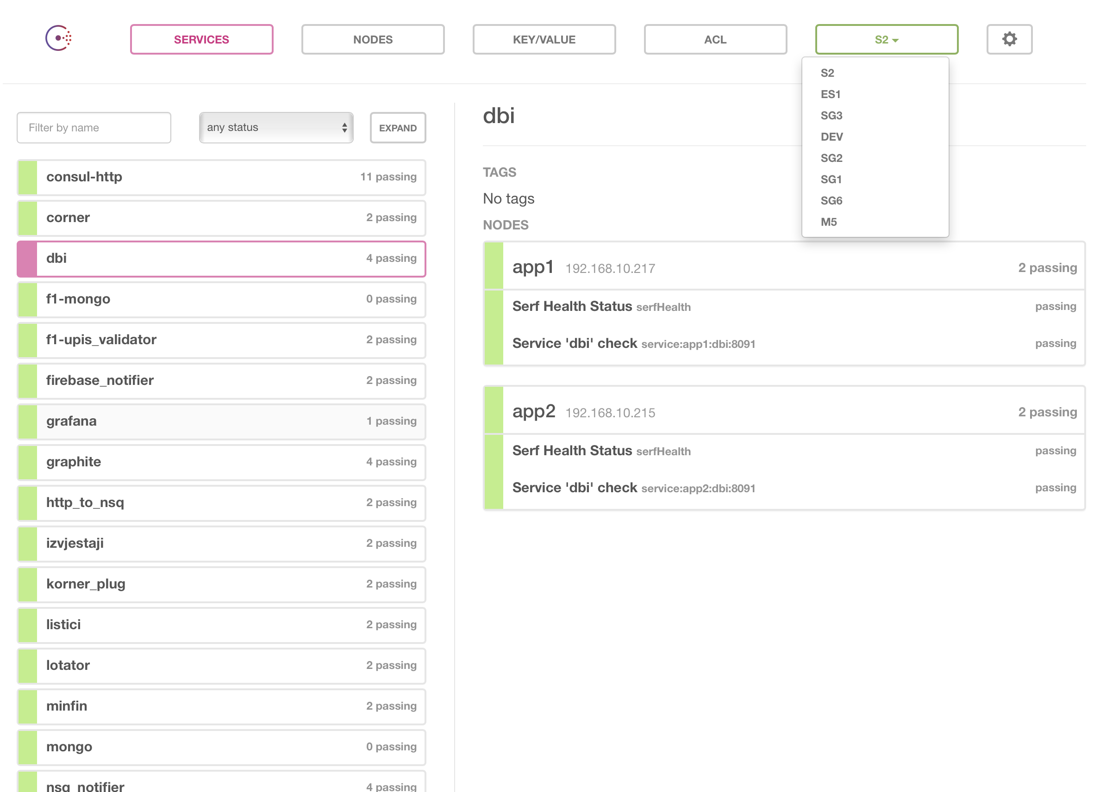

Slide 29
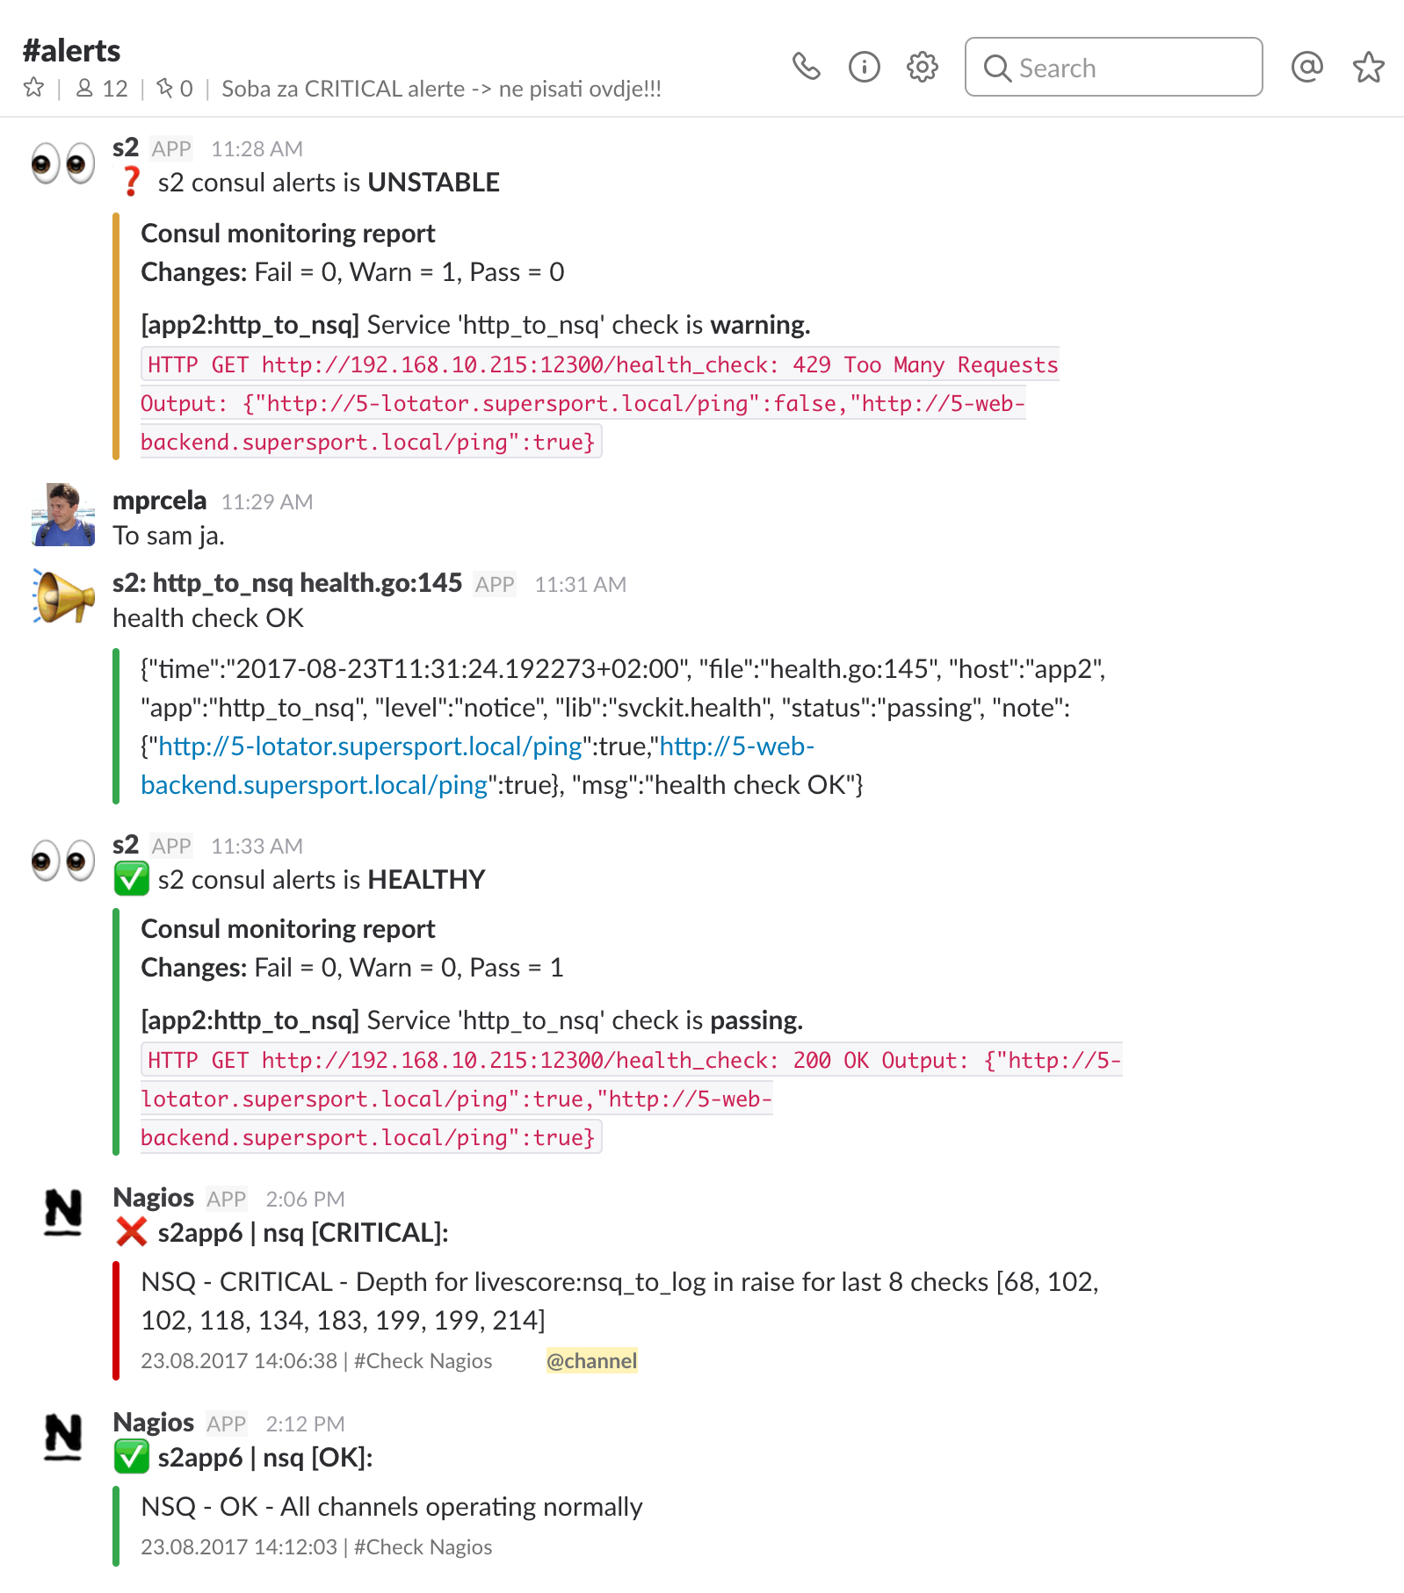

Slide 30
REST
Messaging
You are here
Service Discovery
Containerisation

Slide 31
Containerisation
recipe
image
container

Slide 32
Benefits
service management
service environment
run on my machine
everything is in the code!

Slide 33
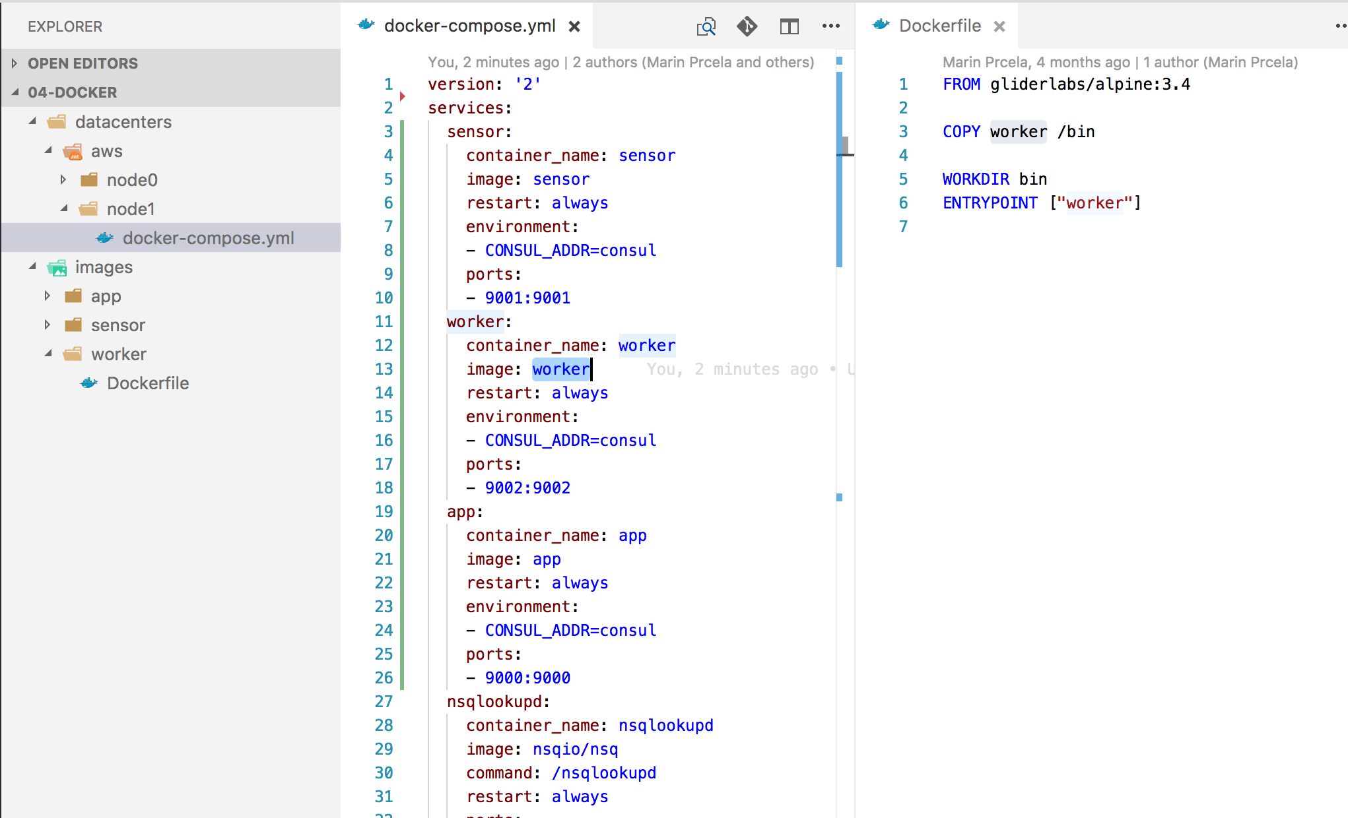

Slide 34
worker
go build
image build
registry
deployer
sensor
app
nsqadmin
logger
nsqadmin
logger
nsqadmin
logger
nsqd
nsqlookupd
nsqd
nsqlookupd
nsqd
nsqlookupd
consul
registrator
consul
registrator
consul
registrator
DEV 01
DEV 02
AWS 01
DEV
datacenter
AWS
datacenter

Slide 35
github.com/minus5/examples-services

Slide 36
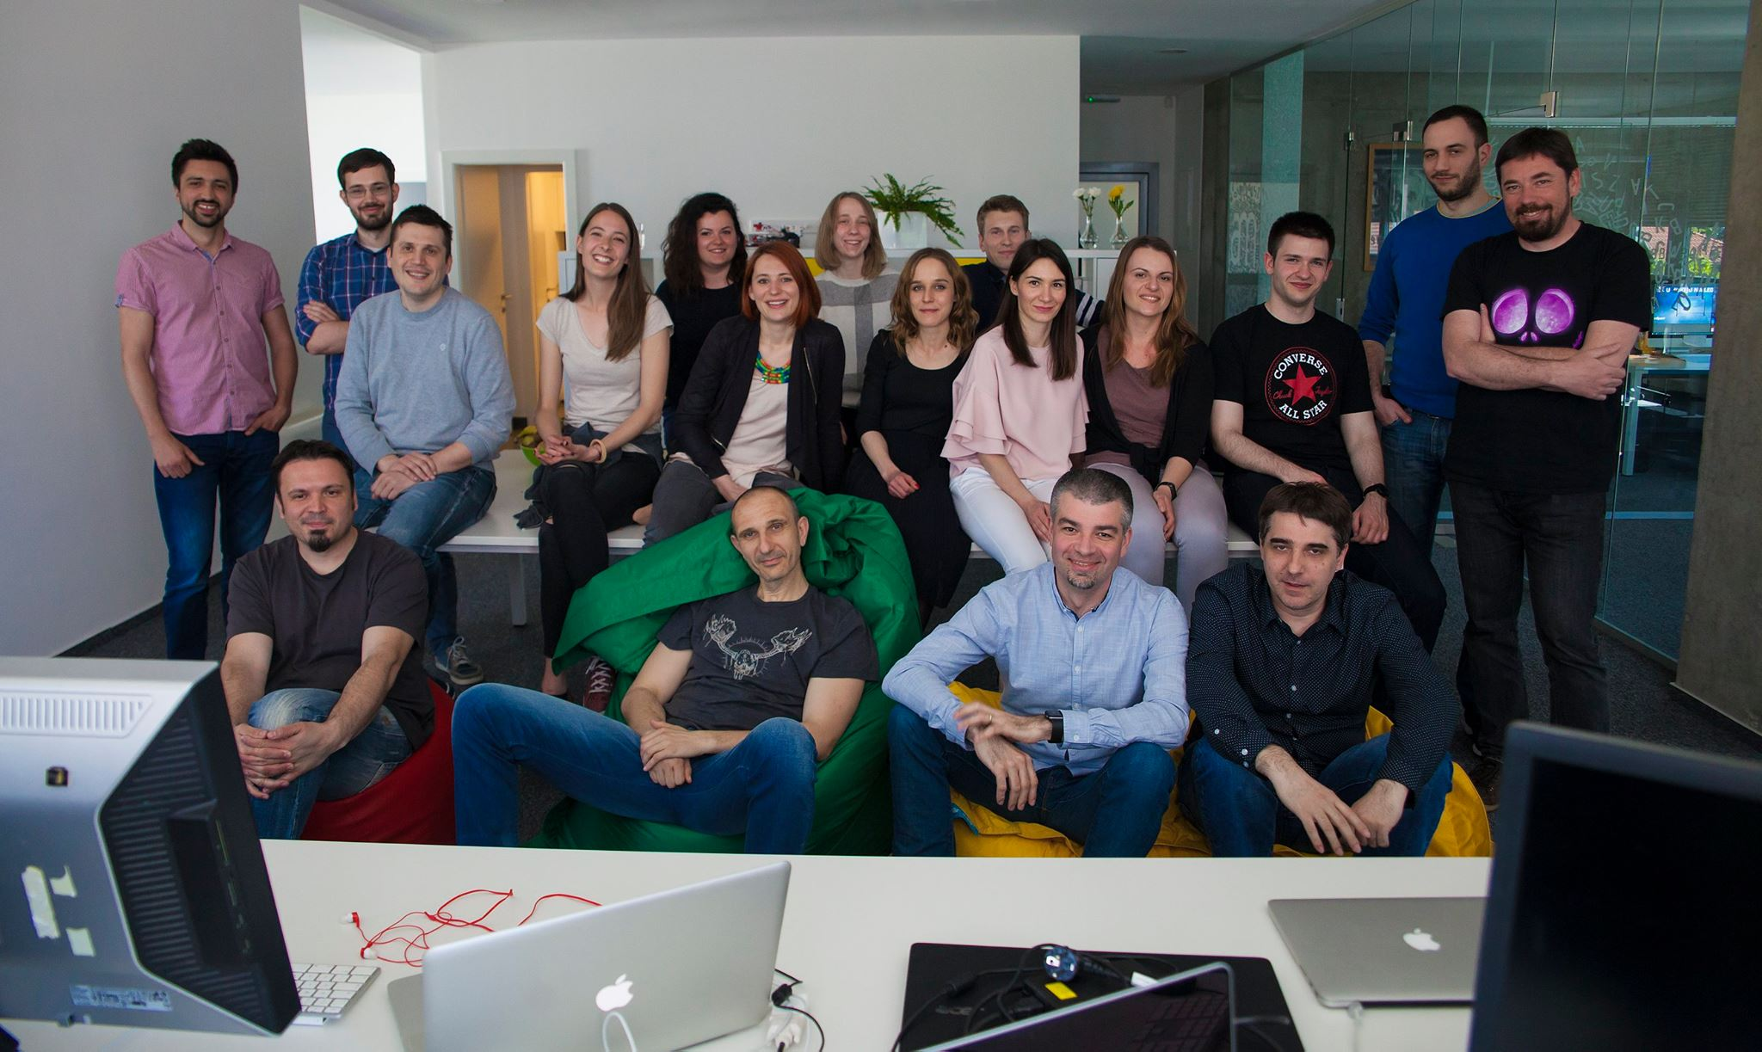
marin.prcela@minus5.hr

